Slide 1
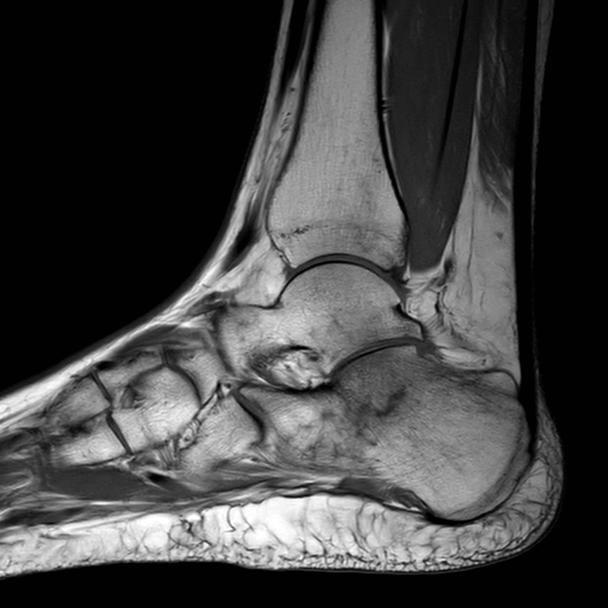
Deep Q-learning in Sagittal Magnetic Resonance Imaging of the Foot and Ankle
Michael J. Robinson

Slide 2
Acknowledgements

Slide 3
Acknowledgements
Thesis Advisor
Jacob Furst, PhD
Thesis Committee
John Rogers, PhD
Noriko Tomuro, PhD
Data source
Mark F. Conneely, MD
Captain James A. Lovell
Federal Health Care VA Center
Other
Thiru Ramaraj, PhD
Jiten Mishra
Joanne Lin

Slide 4
1. Introduction

Slide 5
Long-term goals
Assist radiologists in finding fracture
Foot fracture is quite common: approximately 139 per 100,000 people annually (Chen et al., 2024)
Assist radiologists in finding edema (swelling)
Although less severe than fracture, it can indicate that pathologies are present (Zubler et al., 2007)

Slide 6
Goals of this work
Build a tool that finds edema (swelling) in the foot and ankle using reinforcement learning
Build a tool that segments the calcaneus (heel) bone using reinforcement learning
Can be used in creating bone masks
A preliminary step to finding fracture

Slide 7
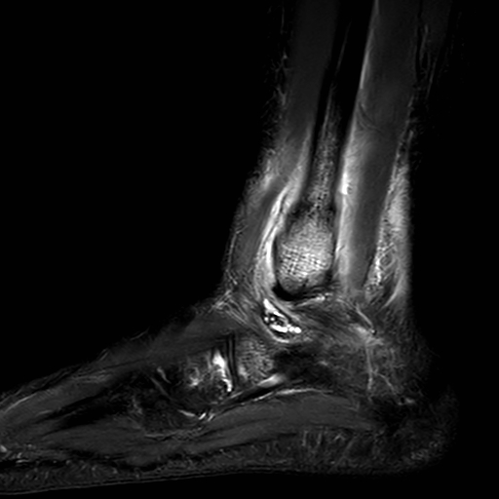
Build a reinforcement learning tool that finds edema
Sagittal Orientation (from the side)
Inversion Recovery (an MRI scan type where water containing regions are bright)
We will call these SAGIR images

Slide 8
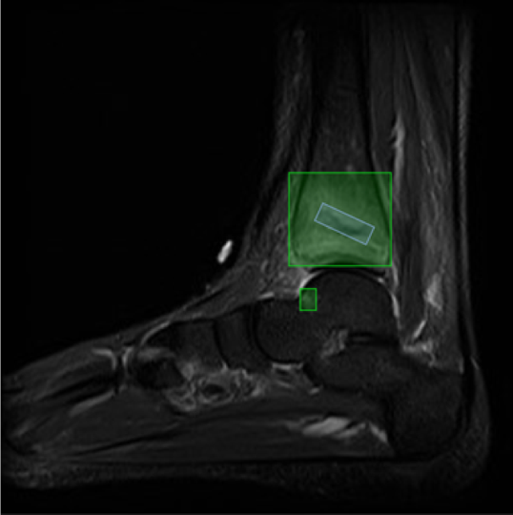
Edema in SAGIR images
Radiologist students overseen by an experienced radiologist provided labels
This work does not directly attempt to identify fracture
The blue box is not used in this image
The green boxes segment edema
The blue box contains a fracture line

Slide 9
Why try to find edema (and not fracture directly)?
Edema usually has a larger Regions of Interest (ROI) than fracture
Easier to detect and segment

Slide 10
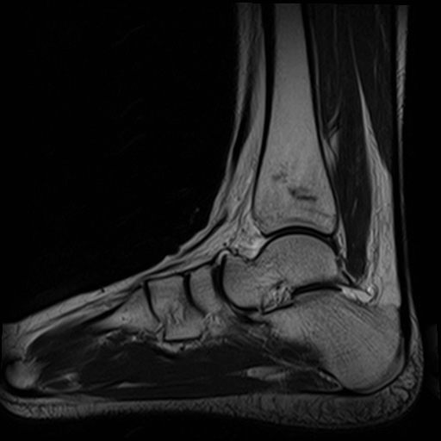
Build a reinforcement learning agent to localize the calcaneus (heel) bone
Sagittal T1 Image (SAGT1)
Good for identifying fine structure

Slide 11
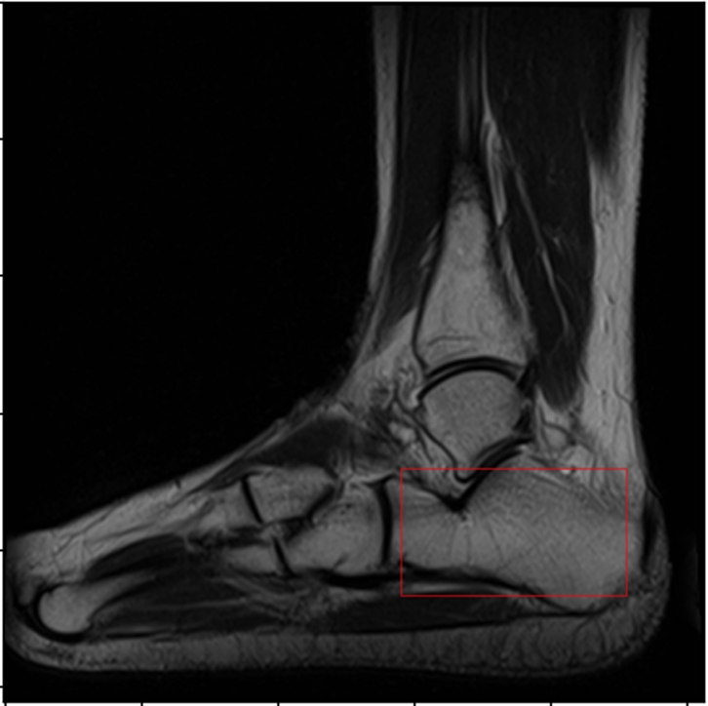
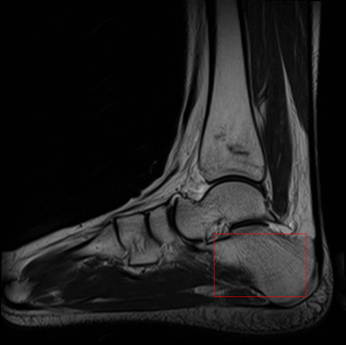
Calcaneus bone in SAGT1 images
Ground truth labels shown below

Slide 12
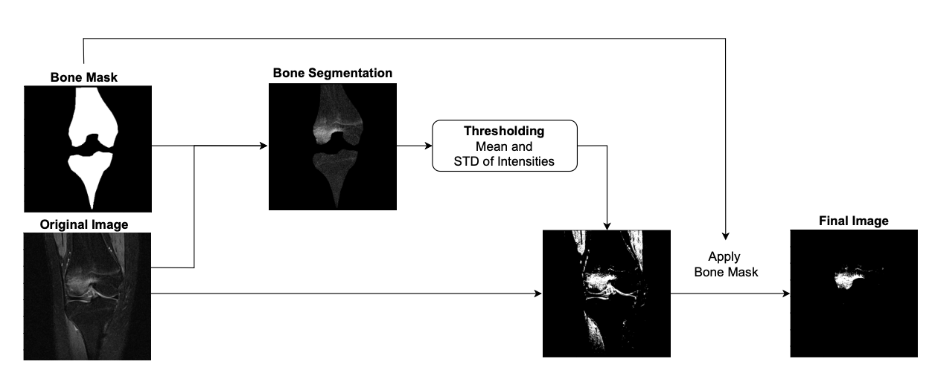
Why segment the calcaneus (heel) bone?
Bone masks can be used as part of a process to detect abnormalities (Ribeiro et al., 2023)
2% of all fractures are of the calcaneus bone (Pranata et al., 2019)
Ribeiro et al., (2023) use bone masks to detect bone marrow edema in the knee

Slide 13
Why MRI ?
Although radiograph is default imaging mode for fracture diagnosis:
MRI is more sensitive than radiograph (Crönlein et al., 2015)
Useful for stress fractures or when radiograph imaging is unclear (Crönlein et al., 2015; Szaro, Polaczek et al., 2020).

Slide 14
2. Background

Slide 15
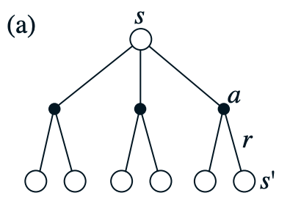
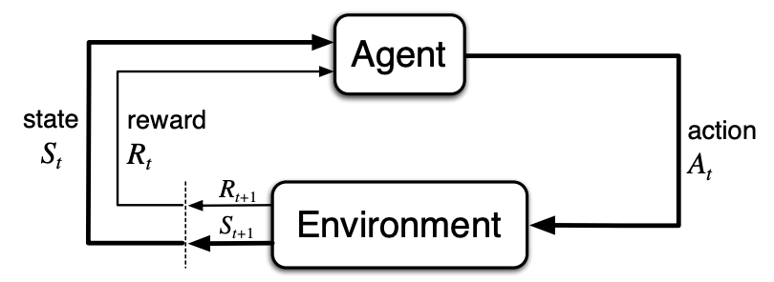
Reinforcement Learning – Markov Decision Processes (MDPs)
A Markov Decision Process (MDP) characterizes how an agent makes decisions to reach a goal in an environment
The environment consists of states and allowed actions
Rewards signal goal progress
Sutton and Barto (2020)

Slide 16
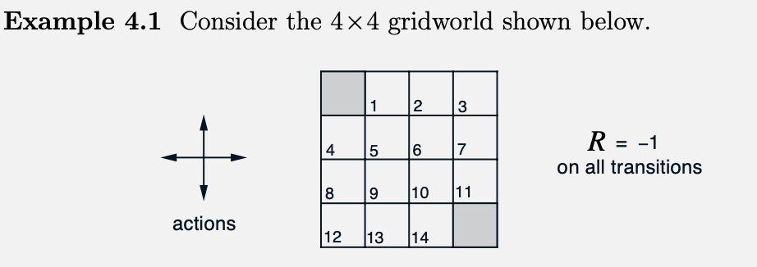
Problem Simplification: Gridworld (Sutton and Barto)
1. States: 16 (two goal states in grey)
2. Actions: 4 (left, right, up, down)
3. Rewards: -1 per step
A

Slide 17
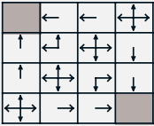
Solution
A (non-optimal) Gridworld policy
Policy – A state to action mapping
An optimal policy maximizes total rewards
Sutton & Barto (2020)

Slide 18
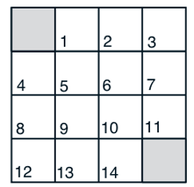
Applying this to my problem
We will now define the Markov Decision Process
This will apply to both the edema and calcaneus experiments

Slide 19
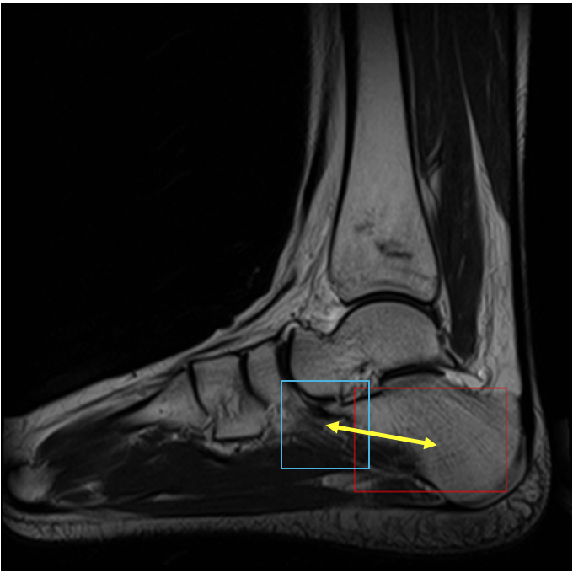
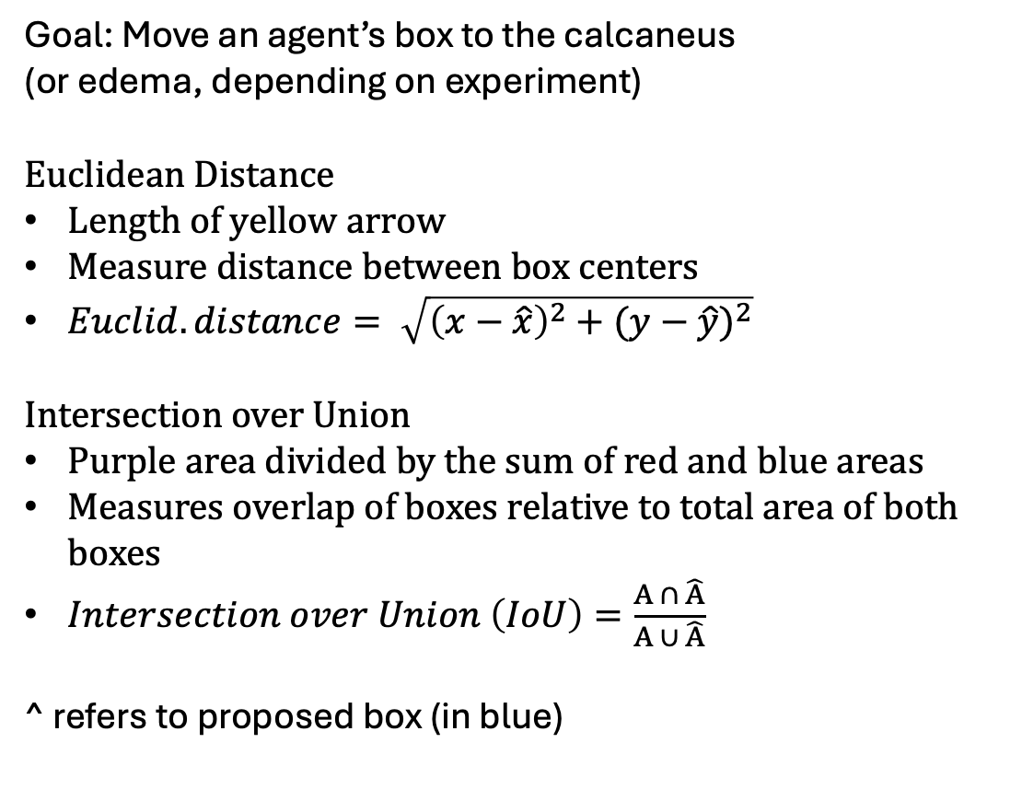
Environment & Goal
Goal: Move an agent’s box to the calcaneus
(or edema, depending on experiment)
Euclidean Distance
Length of yellow arrow
Measure distance between box centers
$Euclid. distance= \sqrt{{\left(x−\hat{x}\right)}^{2}+{(y−\hat{y})}^{2}}$
Intersection over Union
Purple area divided by the sum of red and blue areas
Measures overlap of boxes relative to total area of both boxes
$Intersection over Union \left(IoU\right)=\frac{A ∩ \hat{A}}{A ∪ \hat{A}}$
^ refers to proposed box (in blue)
Euclidean Distance
Intersection over Union (IoU)

Slide 20
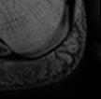
States

Slide 21
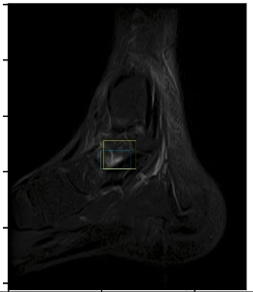
Actions
Vary in my experiments
For now, we’ll only consider 4
Up, down, left, right

Slide 22
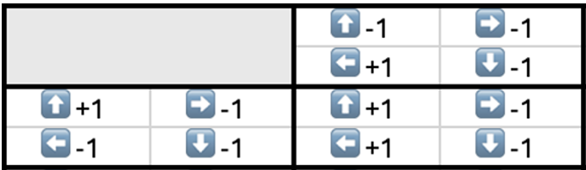
Rewards
+1 if moves closer
-1 if moves further
Caicedo & Lazebnik (2015)
Four possible actions per state
A total of four states shown (includes terminal state)

Slide 23
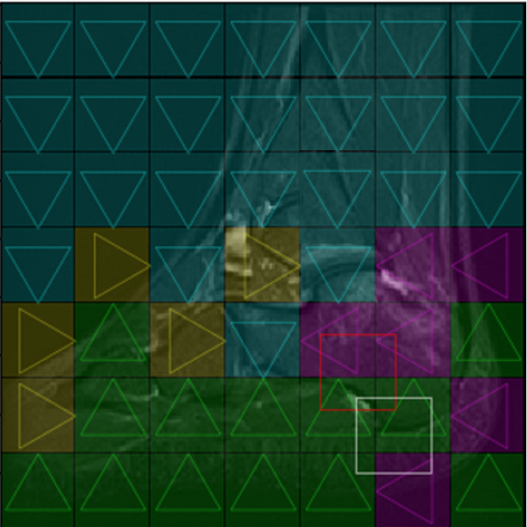
Some non-optimal policies
Two terminal state locations
One terminal state location
Action map:
Red is the terminal state
White is the start state
A non-optimal action mapping for this state

Slide 24
How do we arrive at policies?
Various methods
We will focus on Q-learning

Slide 25
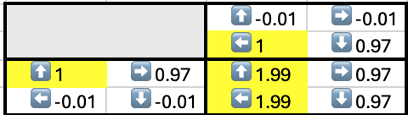
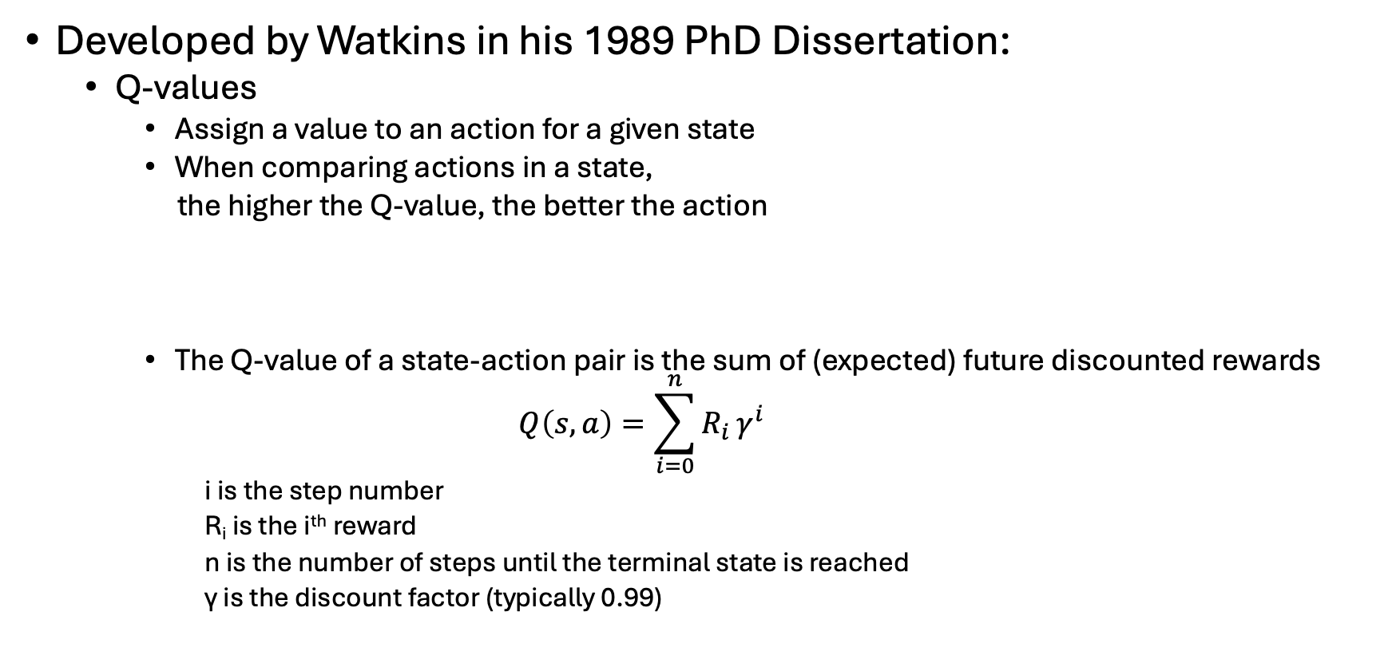
Q learning
Developed by Watkins in his 1989 PhD Dissertation:
Q-values
Assign a value to an action for a given state
When comparing actions in a state,
the higher the Q-value, the better the action
The Q-value of a state-action pair is the sum of (expected) future discounted rewards
$$Q\left(s, a\right)=\sum_{i=0}^{n}{R_{i}}γ^{i}$$
i is the step number
R_{i} is the i^{th} reward
n is the number of steps until the terminal state is reached
γ is the discount factor (typically 0.99)

Slide 26
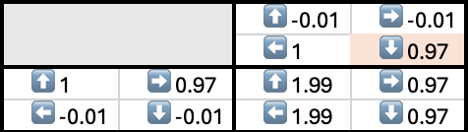
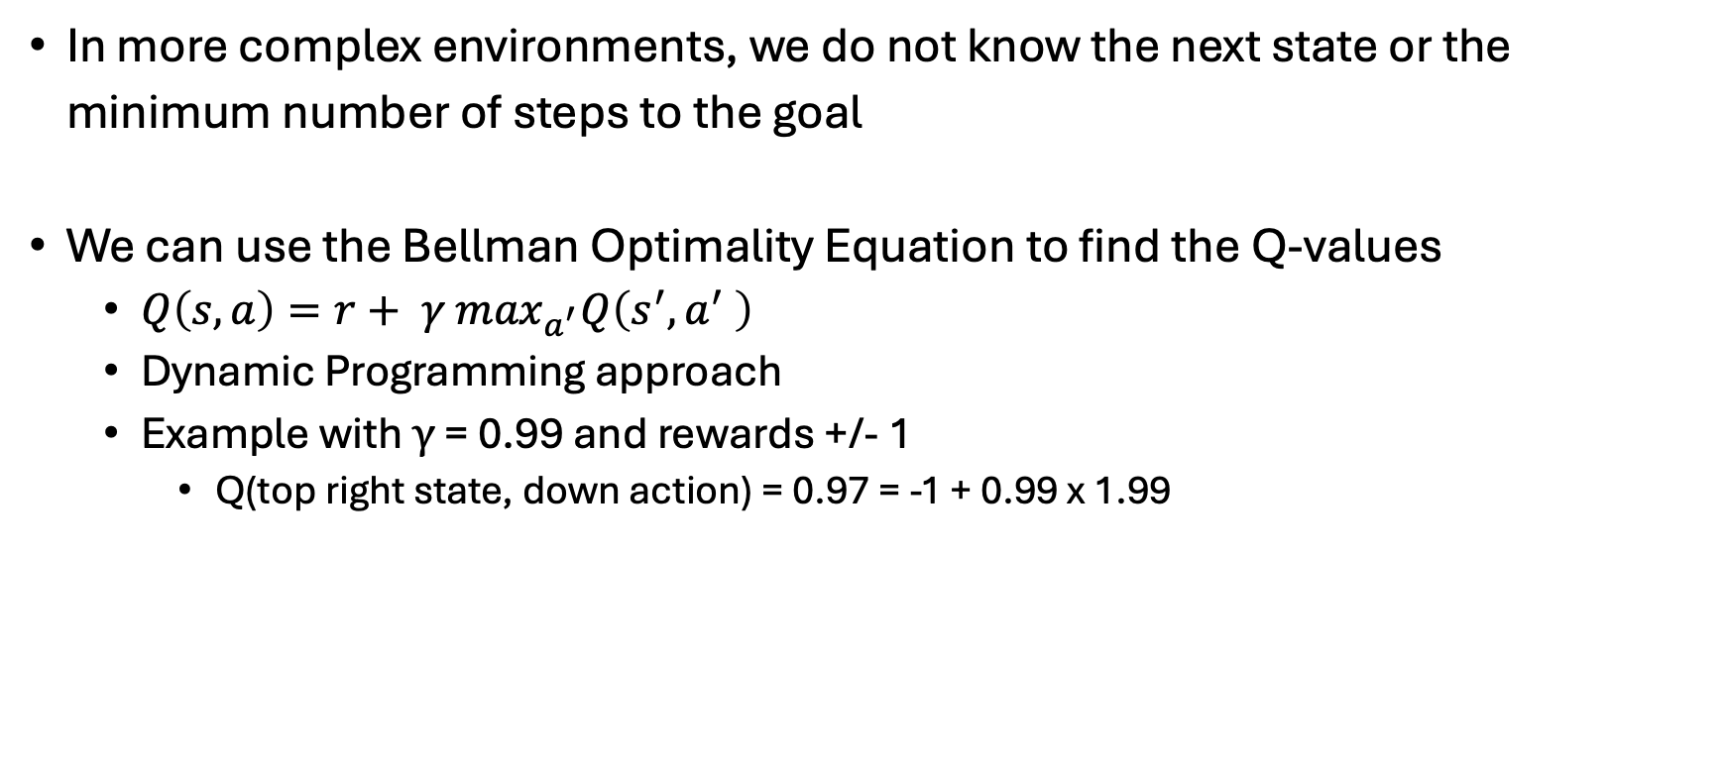
The Bellman Optimality Equation
In more complex environments, we do not know the next state or the minimum number of steps to the goal
We can use the Bellman Optimality Equation to find the Q-values
$Q\left(s, a\right)=r+ γ$ $\max_{a^{′}}Q\left(s^{′}, a^{′} \right)$
Dynamic Programming approach
Example with $γ$ = 0.99 and rewards +/- 1
Q(top right state, down action) = 0.97 = -1 + 0.99 x 1.99

Slide 27
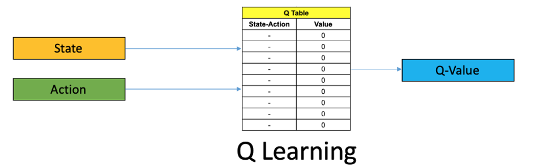
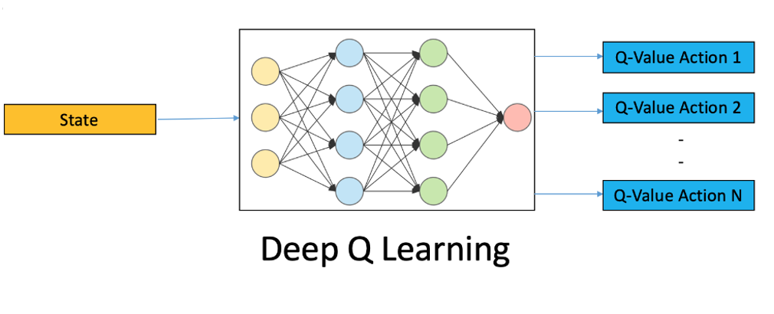
Q learning types
Traditionally, Q-values are stored in a table and updated via dynamic programming
Used for relatively small state spaces
Deep Q learning
Use a neural network to predict Q-values
analyticsvidhya.com

Slide 28
3. Related Works

Slide 29
4. Methods

Slide 30
Dataset
115 young adult patients who experienced foot or ankle pain
Images taken on 1.5T and 3T MRI machines at the Captain James A. Lovell Federal Health Care VA Center
Edema and fracture segmented in SAGIR and SAGT1

Slide 31
Two Experiments
Edema localization (no data augmentation):
28 train slices
24 inference slices
2. Calcaneus segmentation (with augmentation):
568 train slices
288 inference slices

Slide 32
Ground Truth Labels
Edema – Annotated already
Calcaneus – Need to create labels

Slide 33
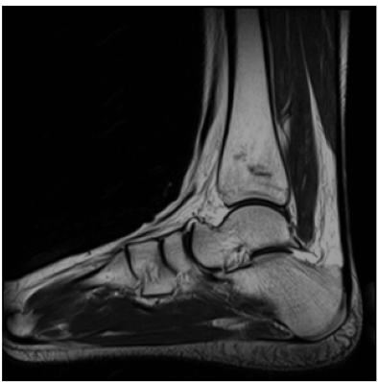
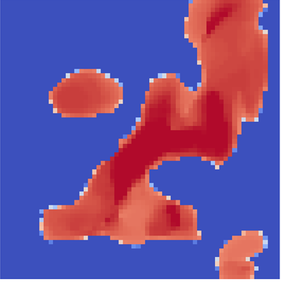
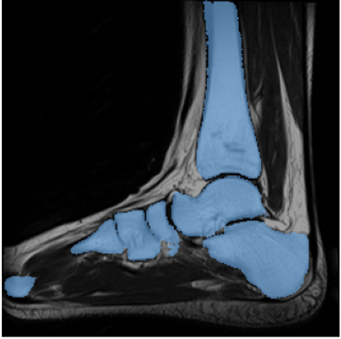
Segment Any Bone (Gu et al., 2024)
Creates attention map
Creates bone mask

Slide 34
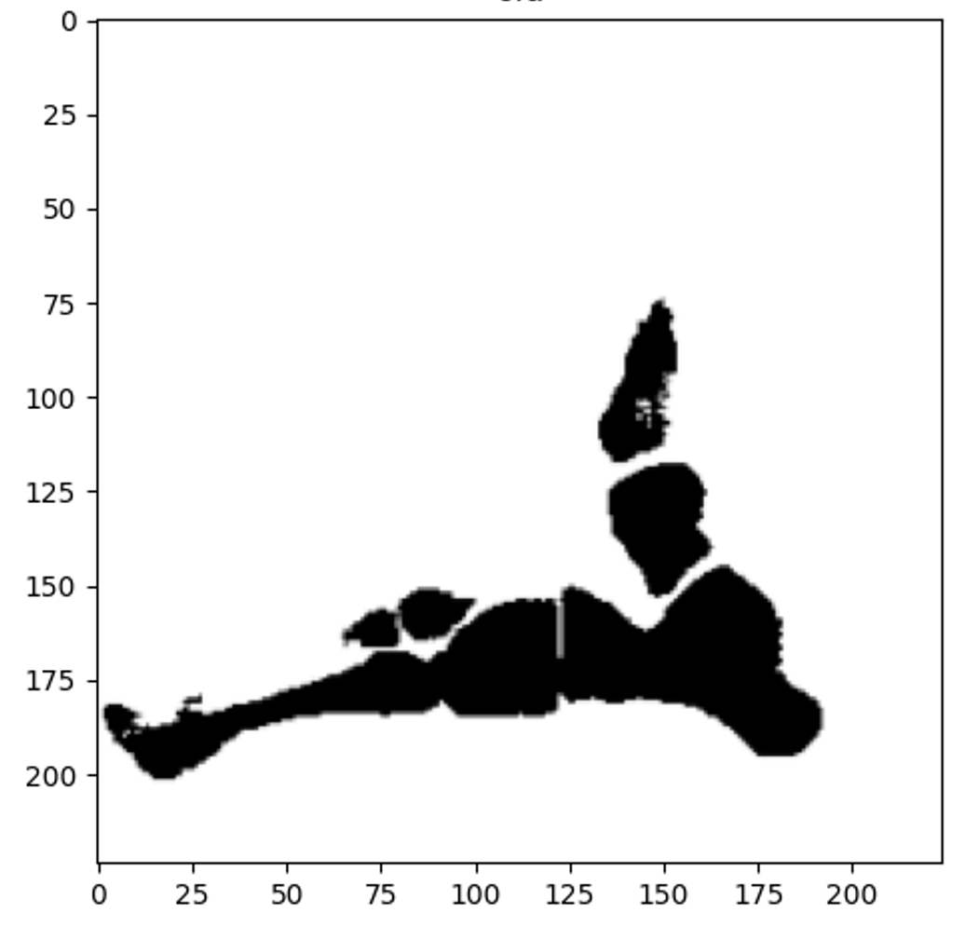
Processing the bone masks
1. Erosion
2. Connected components
3. Outlier detection (discarding bounding boxes whose coordinates are far from the average)
Steps 1, 2 & 3 to make ground truth box

Slide 35
Network Architecture
UP
DOWN
ResNet50
Q-Network
LEFT
RIGHT

Slide 36
ResNet50
Edema segmentation uses the “out of the box” weights from PyTorch Defaults (trained on the ImageNet dataset)
Calcaneus segmentation begins with these weights but then the ResNet is further trained

Slide 37
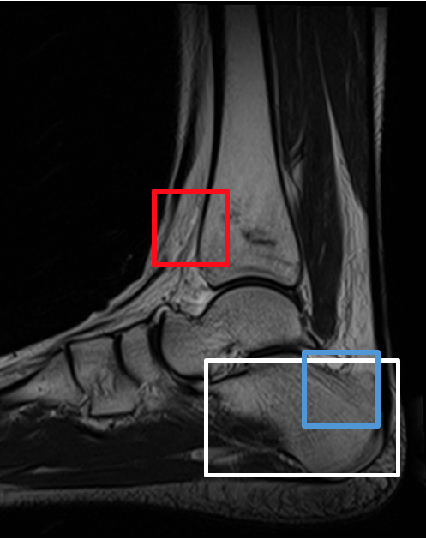
Train ResNet50
Weights are initially the pretrained ResNet50 from ImageNet (PyTorch default weights)
Randomly sampled the training images for positive and negative boxes
25 positive and 25 negative instances from each slice
Given a ground truth box (in white) positive boxes are within a fixed Euclidean distance when comparing centers
568 training slices (which includes 90-, 180- and 270-degree rotations for each original)

Slide 38
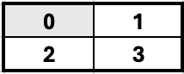
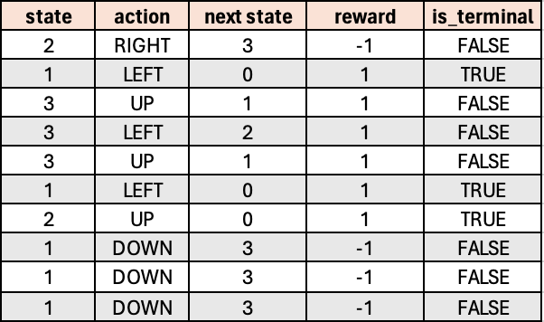
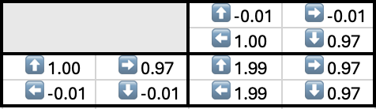
Train the Q-Network
FOR slice in slices:
is_terminal ← FALSE
steps ← 0
WHILE NOT is_terminal:
action ← maxQ(state, actions)
Move(action)
Randomly sample memory
Update policy network weights
If max steps reached:
is_terminal ← TRUE
Append transition (s, a, sʹ, r, is_terminal) to memory
steps ← steps + 1
if steps % C == 0:
Update target network
*Only for edema experiment

Slide 39
5. Results

Slide 40
Two Experiments

Slide 41
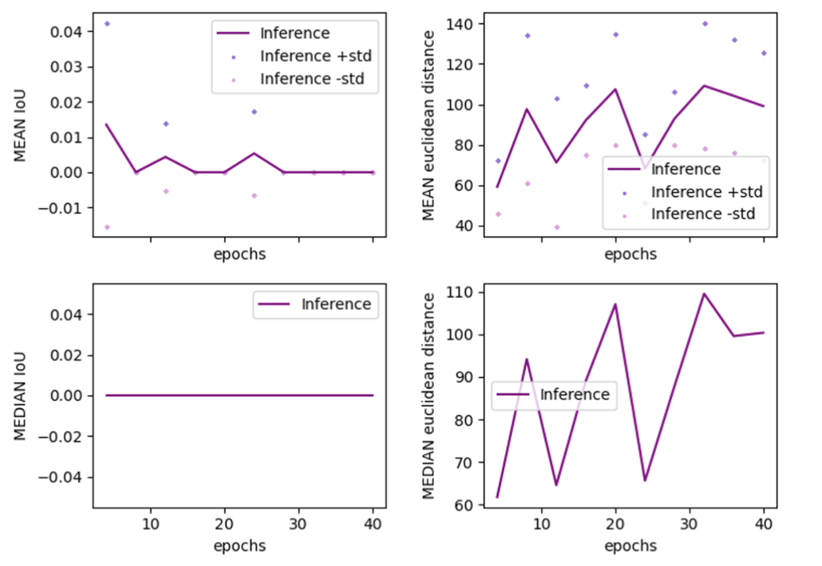
Edema

Slide 42
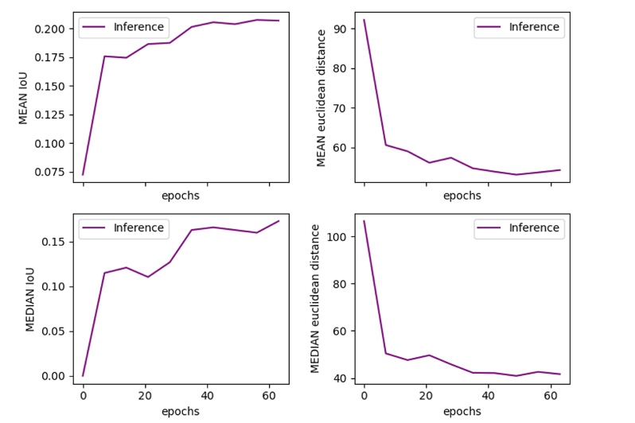
Calcaneus

Slide 43
6. Discussion

Slide 44
Edema experiment
Action maps showing the direction the agent will move in each patch of the image
This idea mainly comes from the works of Li et al. (2018), Noothout et al. (2018) and Xu et al. (2017)
Different colors represent different directions
From various experiments, action maps tended to become more uniform over training
Meaning that the agent overlearned an action and started to favor it in nearly all states

Slide 45
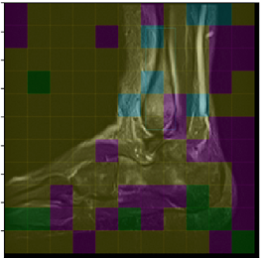
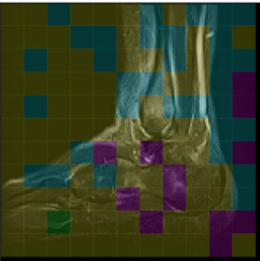
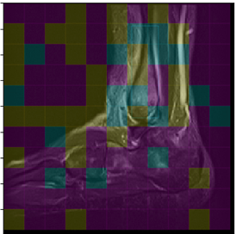
Action map
Each image represents the same inference slice
Colors:
Yellow – Right
Purple – Left
Blue – Down
Green – Up
4 training
epochs
12 training
epochs
8 training
epochs
Number of training epochs between generated action maps

Slide 46
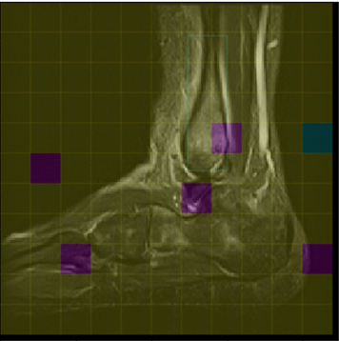
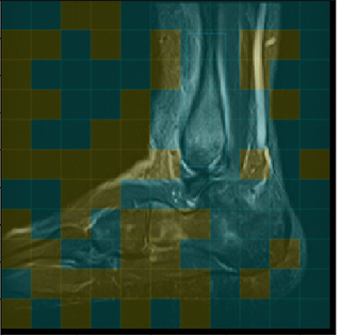
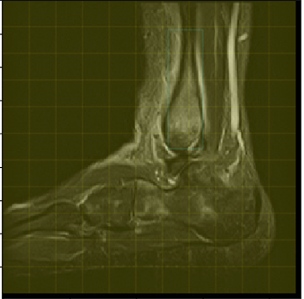
Action map continued
Training continues...
Colors:
Yellow – Right
Purple – Left
Blue – Down
Green – Up
Only MOVE RIGHT action chosen
4 training
epochs
4 training
epochs
8 training
epochs
Number of training epochs between generated action maps

Slide 47
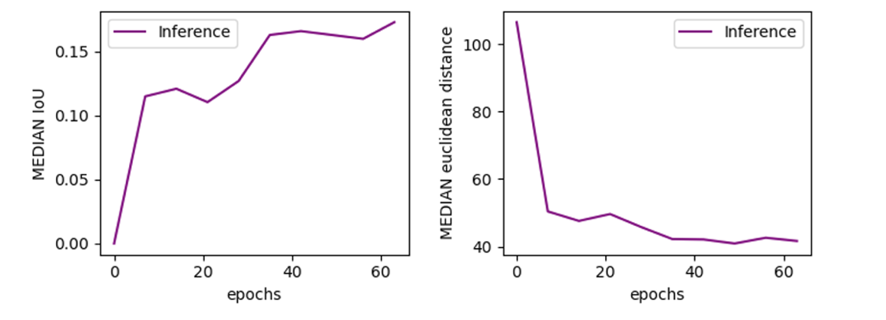
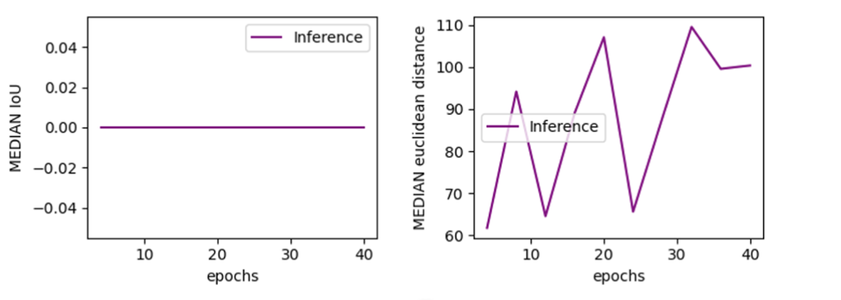
Calcaneus vs edema
Calcaneus
Consistent improvement and stability for calcaneus segmentation
Other experiments involving edema, fluctuated and showed little learning
Edema
Instability (fluctuations)
No learning

Slide 48
Why did edema segmentation not work?
Edema is not in a consistent place in each image
All but two papers had landmarks in a fixed location relative to other structural features
Caicedo & Lazebnik (2015) with non-medical images
But objects in focus and in the foreground of image likely would be easier to localize
Use trigger action, multiple starts and external SVM classifier
Maicas et al. (2017) detected breast lesions in MRI volumes
Perhaps less well-defined structure
Used trigger action and multiple starts
Trigger action needed and multiple starts needed?

Slide 49
7. Conclusion

Slide 50
Overall
Little success in edema
Better understanding of RL and its limitations
Success in calcaneus segmentation
Results can be improved

Slide 51
Future Work: Ideas for Improvement
Only negative rewards
Trigger action
Multiple start locations
External SVM classifier
More complex state representation

Slide 52
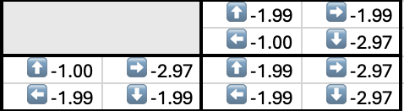
Continue exploration of only negative rewards
Converged Q-values
+1 reward closer
-1 reward further
-1 rewards per step
Larger difference between actions is likely easier for a neural network to distinguish in a noisy environment

Slide 53
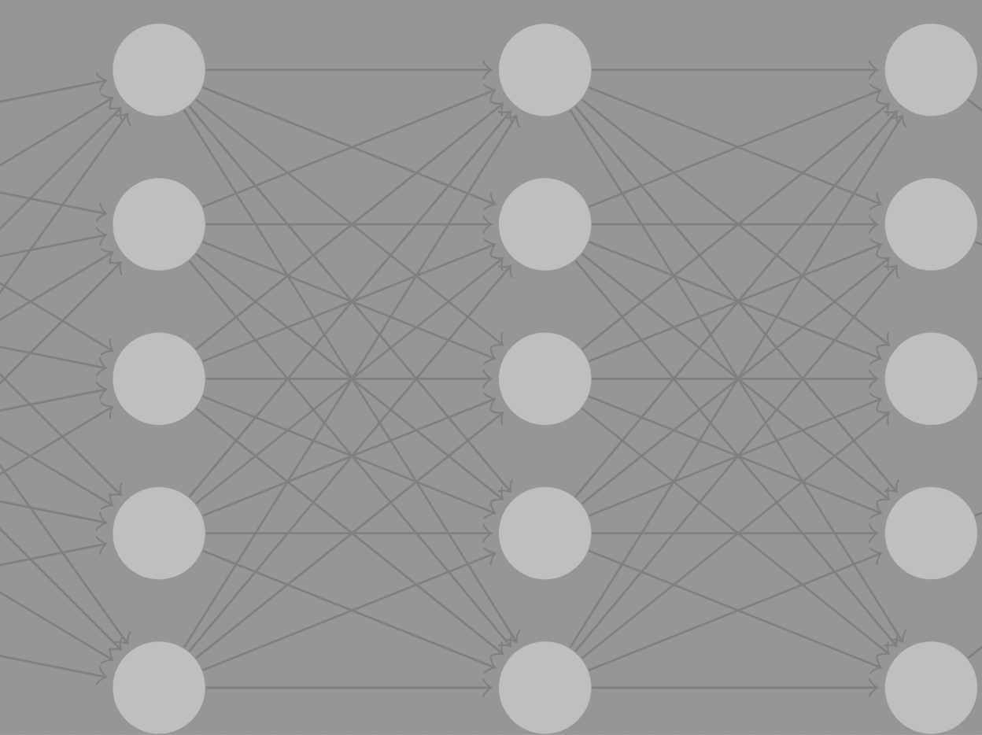
Trigger action
UP
Agent signals when to stop search
As opposed to stopping at a set number of steps, or when oscillation occurs
DOWN
LEFT
RIGHT
image from cs.swarthmore.edu
STOP

Slide 54
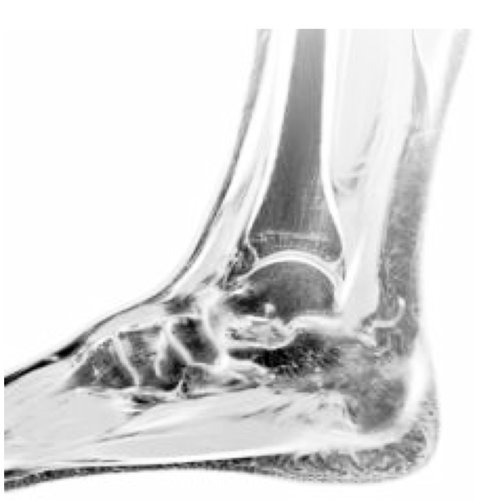
Multiple start locations
Use multiple start locations
Average the ending position for a single landmark
Or use multiple ending positions for multiple landmarks
1
2
3
4

Slide 55
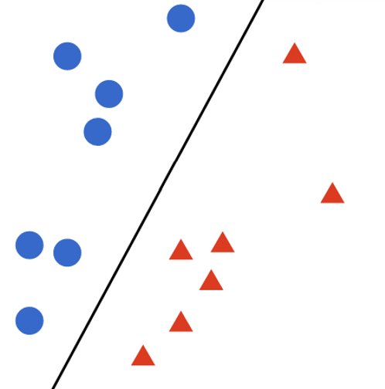
External (SVM) classifier
Calcaneus
Not Calcaneus
Use a trained SVM classifier to determine if terminal states contain the goal
image from monkeylearn.com

Slide 56
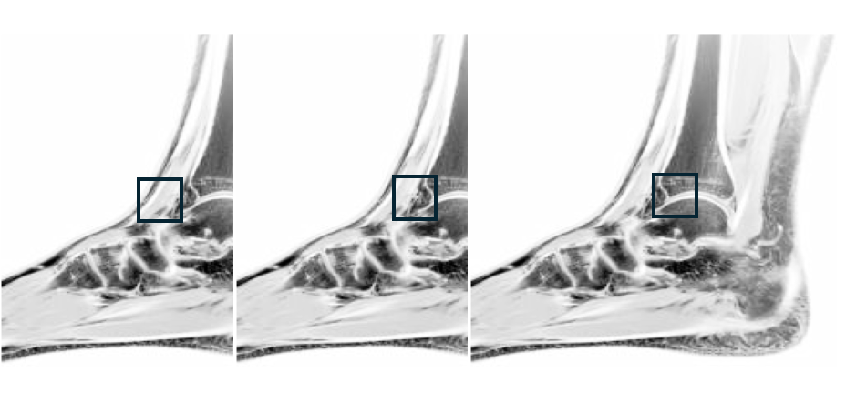
More complex state (previous frames and/or action history)
Multiple frames
Action history
+
[UP, UP, RIGHT, RIGHT, RIGHT]

Slide 57
8. References

Slide 58
Alansary, A., Oktay, O., Li, Y., Folgoc, L. L., Hou, B., Vaillant, G., Kamnitsas, K., Vlontzos, A., Glocker, B., Kainz, B., & Rueckert, D. (2019). Evaluating reinforcement learning agents for anatomical landmark detection. Medical Image Analysis, 53, 156–164. https://doi.org/10.1016/j.media.2019.02.007
Caicedo, J. C., & Lazebnik, S. (2015). Active Object Localization with Deep Reinforcement Learning. 2015 IEEE International Conference on Computer Vision (ICCV), 2488–2496. https://doi.org/10.1109/ICCV.2015.286
Chen, C., Lin, J.-R., Zhang, Y., Ye, T.-B., & Yang, Y.-F. (2024). A systematic analysis on global epidemiology and burden of foot fracture over three decades. Chinese Journal of Traumatology, S1008127524000270. https://doi.org/10.1016/j.cjtee.2024.03.001
Crönlein, M., Rauscher, I., Beer, A. J., Schwaiger, M., Schäffeler, C., Beirer, M., Huber, S., Sandmann, G. H., Biberthaler, P., Eiber, M., & Kirchhoff, C. (2015). Visualization of stress fractures of the foot using PET-MRI: A feasibility study. European Journal of Medical Research, 20(1), 99. https://doi.org/10.1186/s40001-015-0193-6
Gu, H., Colglazier, R., Dong, H., Zhang, J., Chen, Y., Yildiz, Z., Chen, Y., Li, L., Yang, J., Willhite, J., Meyer, A. M., Guo, B., Shah, Y. A., Luo, E., Rajput, S., Kuehn, S., Bulleit, C., Wu, K. A., Lee, J., ... Mazurowski, M. A. (2024). SegmentAnyBone: A Universal Model that Segments Any Bone at Any Location on MRI (arXiv:2401.12974). arXiv. http://arxiv.org/abs/2401.12974
Li, Y., Alansary, A., Cerrolaza, J. J., Khanal, B., Sinclair, M., Matthew, J., Gupta, C., Knight, C., Kainz, B., & Rueckert, D. (2018). Fast Multiple Landmark Localisation Using a Patch-Based Iterative Network. In A. F. Frangi, J. A. Schnabel, C. Davatzikos, C. Alberola-López, & G. Fichtinger (Eds.), Medical Image Computing and Computer Assisted Intervention – MICCAI 2018 (Vol. 11070, pp. 563–571). Springer International Publishing. https://doi.org/10.1007/978-3-030- 00928-1_64
Maicas, G., Carneiro, G., Bradley, A. P., Nascimento, J. C., & Reid, I. (2017). Deep Reinforcement Learning for Active Breast Lesion Detection from DCE-MRI. In M. Descoteaux, L. Maier-Hein, A. Franz, P. Jannin, D. L. Collins, & S. Duchesne (Eds.), Medical Image Computing and Computer Assisted Intervention − MICCAI 2017 (Vol. 10435, pp. 665–673). Springer International Publishing. https://doi.org/10.1007/978-3-319-66179-7_76
Mnih, V., Kavukcuoglu, K., Silver, D., Rusu, A. A., Veness, J., Bellemare, M. G., Graves, A., Riedmiller, M., Fidjeland, A. K., Ostrovski, G., Petersen, S., Beattie, C., Sadik, A., Antonoglou, I., King, H., Kumaran, D., Wierstra, D., Legg, S., & Hassabis, D. (2015). Human-level control through deep reinforcement learning. Nature, 518(7540), 529–533. https://doi.org/10.1038/nature14236
Noothout, J. M. H., de Vos, B. D., Wolterink, J. M., Leiner, T., & Išgum, I. (2018). CNN-based Landmark Detection in Cardiac CTA Scans (arXiv:1804.04963). arXiv. http://arxiv.org/abs/1804.04963
Pranata, Y. D., Wang, K.-C., Wang, J.-C., Idram, I., Lai, J.-Y., Liu, J.-W., & Hsieh, I.-H. (2019). Deep learning and SURF for automated classification and detection of calcaneus fractures in CT images. Computer Methods and Programs in Biomedicine, 171, 27–37. https://doi.org/10.1016/j.cmpb.2019.02.006
PyTorch. (2024). Reinforcement Learning (DQN) Tutorial. Retrieved August 11, 2024. https://pytorch.org/tutorials/intermediate/reinforcement_q_learning.html
Ribeiro, G., Pereira, T., Silva, F., Sousa, J., Carvalho, D. C., Dias, S. C., & Oliveira, H. P. (2023). Learning Models for Bone Marrow Edema Detection in Magnetic Resonance Imaging. Applied Sciences, 13(2), 1024. https://doi.org/10.3390/app13021024
Sutton, R. S., & Barto, A. G. (2020). Reinforcement learning: An introduction (2nd ed.). MIT Press.
Szaro, P., Polaczek, M., Świątkowski, J., & Kocoń, H. (2020). How to increase the accuracy of the diagnosis of the accessory bone of the foot? La Radiologia Medica, 125(2), 188–196. https://doi.org/10.1007/s11547-019-01104-x
Watkins, C. J. C. H., & Dayan, P. (1992). Q-learning. Machine Learning, 8(3), 279-292. https://doi.org/10.1007/BF00992698
Xu, Z., Huang, Q., Park, J., Chen, M., Xu, D., Yang, D., Liu, D., & Zhou, S. K. (2017). Supervised Action Classifier: Approaching Landmark Detection as Image Partitioning. In M. Descoteaux, L. Maier-Hein, A. Franz, P. Jannin, D. L. Collins, & S. Duchesne (Eds.), Medical Image Computing and Computer Assisted Intervention − MICCAI 2017 (Vol. 10435, pp. 338–346). Springer International Publishing. https://doi.org/10.1007/978-3-319-66179-7_39
Zubler, V., Mengiardi, B., Pfirrmann, C. W. A., Duc, S. R., Schmid, M. R., Hodler, J., & Zanetti, M. (2007). Bone marrow changes on STIR MR images of asymptomatic feet and ankles. European Radiology, 17(12), 3066–3072. https://doi.org/10.1007/s00330-007-0691-1

Slide 59
Questions?

Slide 60
Supplemental Slides

Slide 61
S1. Introduction Supplement

Slide 62
S2. Background Supplement

Slide 63
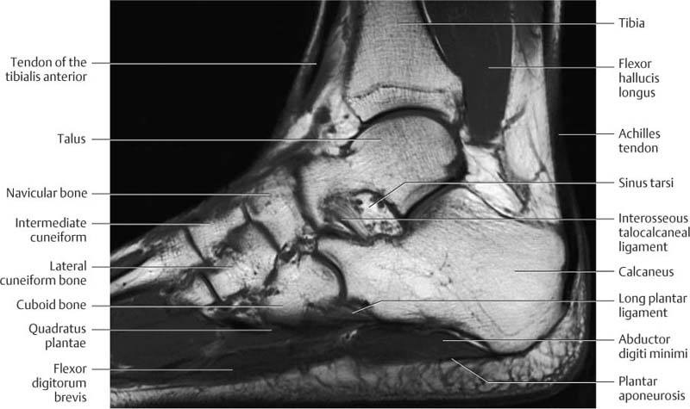
Foot Anatomy

Slide 64
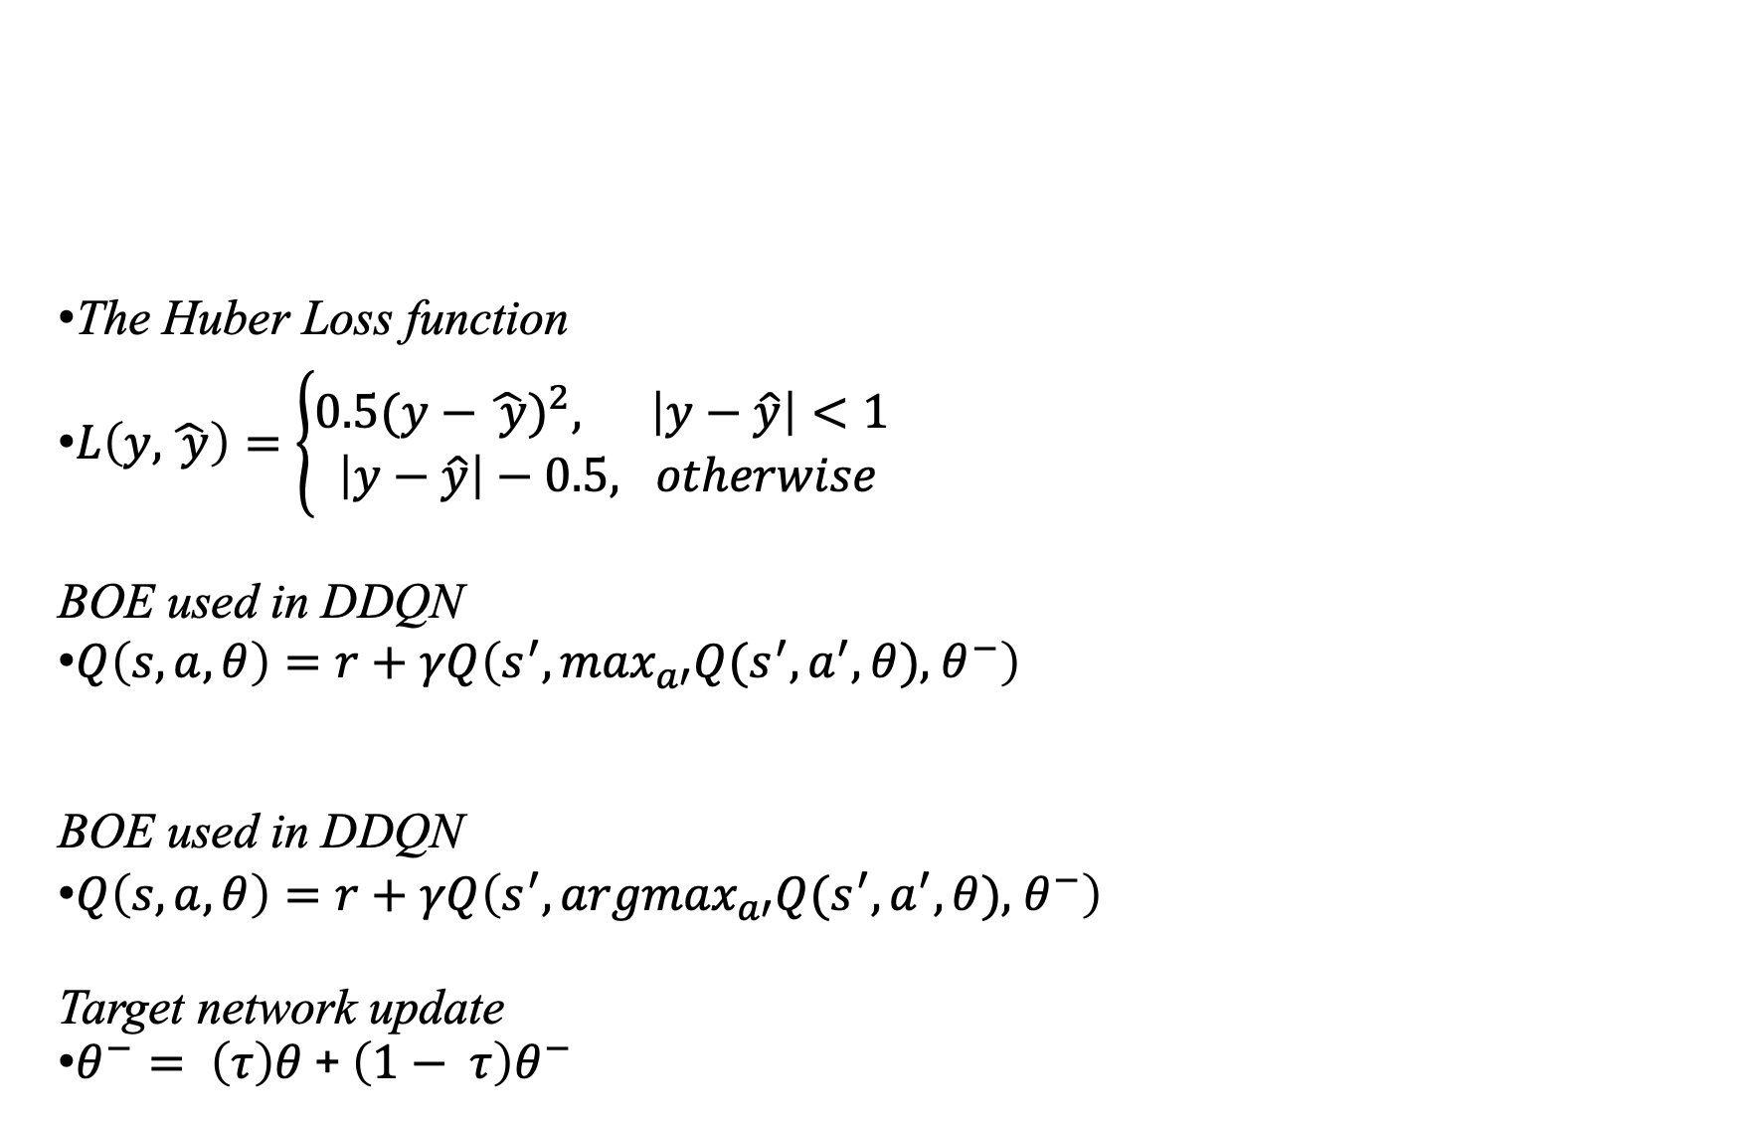
Some Relevant Equations
The Huber Loss function
$L\left(y,\hat{ y}\right)=\left\{\begin{aligned}{0.5(y−\hat{ y})}^{2}, \left|y−\hat{y}\right|<1 \\ \left|y−\hat{y}\right|−0.5, otherwise\end{aligned}\right.$
BOE used in DDQN
$Q\left(s, a, θ\right)=r+γQ\left(s^{′}, {\max_{a′}Q(s^{′},a}^{′},θ),{ θ}^{−}\right)$
BOE used in DDQN
$Q\left(s, a, θ\right)=r+γQ\left(s^{′}, {{argmax}_{a′}Q(s^{′},a}^{′},θ),{ θ}^{−}\right)$
Target network update
$θ^{−}= \left(τ\right)θ$ + $\left(1− τ\right)θ^{−}$

Slide 65
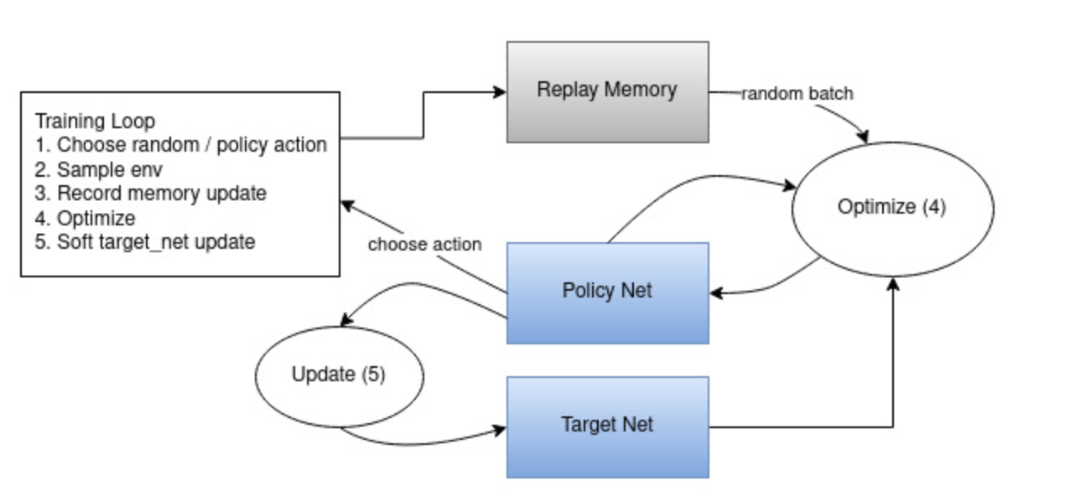
DQN training loop
From PyTorch (2024)

Slide 66


Gridworld
Reward:
+1 closer to goal
-1 farther from goal
$$γ=0.99$$

Slide 67
S3. Related Works Supplement

Slide 68

Some early related works
Note. From Alansary et al. (2019).

Slide 69

Xu et al.

Slide 70
S4. Methods Supplement

Slide 71


Network input modes (any or all combined)
Slice Pad Fit

Slide 72

Making calcaneus ground truths

Slide 73

ResNet 50 channel visuals

Slide 74


Slide 75


Slide 76


Slide 77


Slide 78


Slide 79


Slide 80


Slide 81
S5. Results Supplement

Slide 82


Slide 83


Slide 84

Supervised experiments A-D
BCE loss
Default ResNet weights except lowest layer, final layer stripped away
FIT
20 pos, 20 neg from each image
568 train, 288 val. (includes augmentation)
Euclid. 10 pixels
32 size box
1e-4 LR Adam
32 batch
64 batch (val)

Slide 85

Calcaneus Experiments

Slide 86
S6. Discussion Supplement

Slide 87
S7. Conclusion Supplement

Slide 88
Jacob Questions
*Send bio* - length today
9am Friday 25th
Button down no jeans
Thank you card
Coffee w Jacob for
Details about defense:
Logistics /coordinating?
Will also be available on zoom for remote users?
Hard cut off 50 min presentation – is there a max length??
Then audience leaves and committee asks me detailed questions?
Any prep I should do, outside of a general refresh?
Reread my thesis in entirety

